Slide 1

Scope of an Identifier

Slide 2
Scope of an Identifier
Scope of an identifier: where in the program the identifier is accessible
Local identifier: identifiers declared within a function (or block)
Global identifier: identifiers declared outside of every function definition
C++ does not allow nested functions
Definition of one function cannot be included in the body of another function

Slide 3
Rules Applied When an Identifier is Accessed
Global identifiers are accessible by a function or block if:
The identifier is declared before the function definition (block)
The function name different from the identifier
All parameters to the function have different names than the identifier name
All local identifiers have different names than the identifier name
https://replit.com/@btaylan/CISC3142Codes#Lecture-5/1.cpp
https://replit.com/@btaylan/CISC3142Codes#Lecture-5/2.cpp
https://replit.com/@btaylan/CISC3142Codes#Lecture-5/3.cpp

Slide 4
Rules Applied When an Identifier is Accessed
(Nested block) – an identifier declared within a block is accessible:
From its point of declaration to the end of the block in which it is declared
Within nested blocks if no identifier with the same name exists
The scope of a function name is similar to the scope of an identifier declared outside any block
The function name scope is the same as the global variable scope
https://replit.com/@btaylan/CISC3142Codes#Lecture-5/4.cpp

Slide 5
Other Notes about Global Variables
Some compilers initialize global variables to default values
The scope resolution operator in C++ is ::
By using the scope resolution operator:
A global variable declared before the definition of a function (or block) can be accessed by the function (or block) even if the function (or block) has an identifier with the same name as the global variable
https://replit.com/@btaylan/CISC3142Codes#Lecture-5/5.cpp

Slide 6
Other Notes about Global Variables
To access a global variable declared after the definition of a function, the function must not contain any identifier with the same name
Reserved word extern indicates that a global variable has been declared elsewhere
https://replit.com/@btaylan/CISC3142Codes#Lecture-5/6.cpp

Slide 7
Global Variables, Named Constants, and Side Effects
Using global variables causes side effects
If more than one function uses the same global variable:
It can be difficult to debug problems with the code
Problems caused in one area of the program may appear to be from another area
Global named constants have no side effects because their value is fixed and cannot be changed
https://replit.com/@btaylan/CISC3142Codes#Lecture-5/7.cpp

Slide 8
Static and Automatic Variables
Automatic variable: memory is allocated at block entry and deallocated at block exit
By default, variables declared within a block are automatic variables
Static variable: memory remains allocated as long as the program executes
Global variables declared outside of any block are static variables

Slide 9

Static and Automatic Variables
Declare a static variable within a block by using the reserved word static
The syntax for declaring a static variable is:
Static variables declared within a block are local to the block
Have same scope as any other local identifier in that block
https://replit.com/@btaylan/CISC3142Codes#Lecture-5/8.cpp

Slide 10
Function Overloading
Function overloading (or overloading a function name) occurs when creating several functions with the same name
Two functions are said to have different formal parameter lists if both functions have either:
A different number of formal parameters
If the number of formal parameters is the same, but the data type of the formal parameters differs in at least one position

Slide 11
Function Overloading
Overloaded functions must have different formal parameter lists
The signature: the name and formal parameter list of the function
Does not include the return type of the function
The parameter list supplied in a call to an overloaded function determines which function is executed

Slide 12
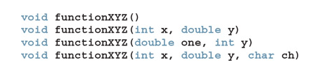
Function Overloading- Void

Slide 13
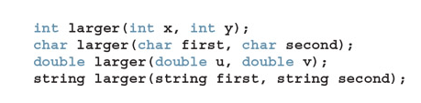

Function Overloading- Value Returning
Error!!!!! Even though return types are different, function signatures (name + formal parameters) cannot be the same!!!! Because compiler cannot determine which one is called
https://replit.com/@btaylan/CISC3142Codes#Lecture-5/9.cpp

Slide 14
Functions with Default Parameters
In a function call, the number of actual and formal parameters must be the same
C++ relaxes this condition for functions with default parameters
Can specify the value of a default parameter in the function prototype
If you do not specify the value for a default parameter when calling the function, the default value is used
All default parameters must be the rightmost parameters of the function
Default values can be constants, global variables, or function calls
Cannot assign a constant value as a default value to a reference parameter
https://replit.com/@btaylan/CISC3142Codes#Lecture-5/10.cpp

Slide 15
User-Defined Simple Data Types

Slide 16
Enumeration
A data type is a set of values with a set of operations on them
Enumeration type is a simple data type created by the programmer
To define an enumeration type, you need:
A name for the data type
A set of values for the data type
A set of operations on the values

Slide 17

Enumeration
You can specify the name and the values, but not the operations
The syntax for enumeration type is:
value1, value2, … are identifiers called enumerators.
List specifies the ordering:
value1 < value2 < value3 <...

Slide 18
Enumeration
The enumeration type is an ordered set of values
Default value assigned to enumerators starts at 0, and then
A value used in one enumeration type cannot be used by another in the same block
Same rules apply to enumeration types declared outside of any blocks

Slide 19
Enumeration
EXAMPLE :
enum colors {BROWN, BLUE, RED, GREEN, YELLOW};
defines a new data type called colors, and the values belonging to this data type are BROWN, BLUE, RED, GREEN, and YELLOW.
EXAMPLE :
enum standing {FRESHMAN, SOPHOMORE, JUNIOR, SENIOR};
defines standing to be an enumeration type. The values belonging to standing are FRESHMAN, SOPHOMORE, JUNIOR, and SENIOR.

Slide 20
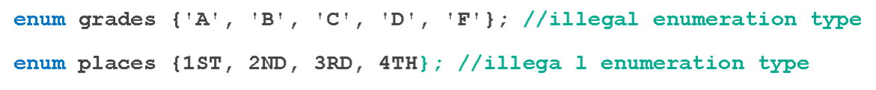
Enumeration
EXAMPLE
Consider the following statements:
These are illegal enumeration types because none of the values is an identifier. The following, however, are legal enumeration types:
enum grades {A, B, C, D, F};
enum places {FIRST, SECOND, THIRD, FOURTH};

Slide 21
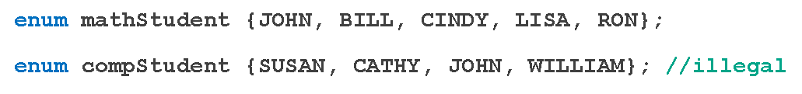
Enumeration
EXAMPLE
Consider the following statements:
Suppose that these statements are in the same program in the same block. The second enumeration type, compStudent, is not allowed because the value JOHN was used in the previous enumeration type mathStudent.z
https://replit.com/@btaylan/CISC3142Codes#Lecture-5/11.cpp

Slide 22

Declaring Variables
Syntax
enum sports {BASKETBALL, FOOTBALL, HOCKEY, BASEBALL, SOCCER,
VOLLEYBALL};
Can declare variables such as:
sports popularSport, mySport;

Slide 23
Assignment
popularSport = FOOTBALL;
Values can be stored in enumeration data types:
https://replit.com/@btaylan/CISC3142Codes#Lecture-5/12.cpp

Slide 24
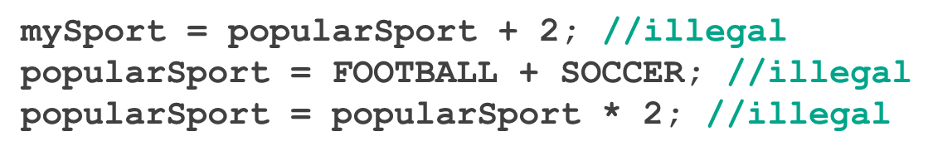

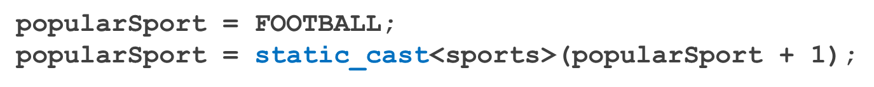
Operations on Enumeration Types
No arithmetic operations are allowed on enumeration types
++ and -- are illegal, too
https://replit.com/@btaylan/CISC3142Codes#Lecture-5/13.cpp
The solution is applying the cast operator

Slide 25
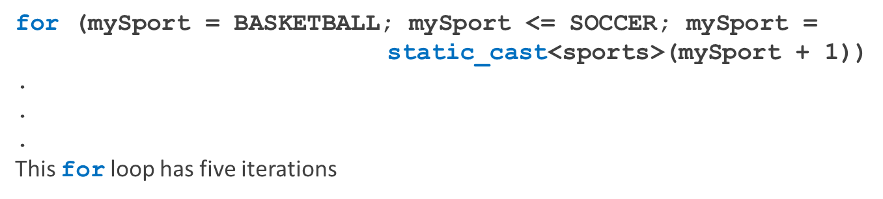
Relational Operators
An enumeration type is an ordered set of values:
FOOTBALL <= SOCCER is true
HOCKEY > BASKETBALL is true
BASEBALL < FOOTBALL is false
https://replit.com/@btaylan/CISC3142Codes#Lecture-5/14.cpp
An enumeration type is an integral data type and can be used in loops:
https://replit.com/@btaylan/CISC3142Codes#Lecture-5/15.cpp

Slide 26
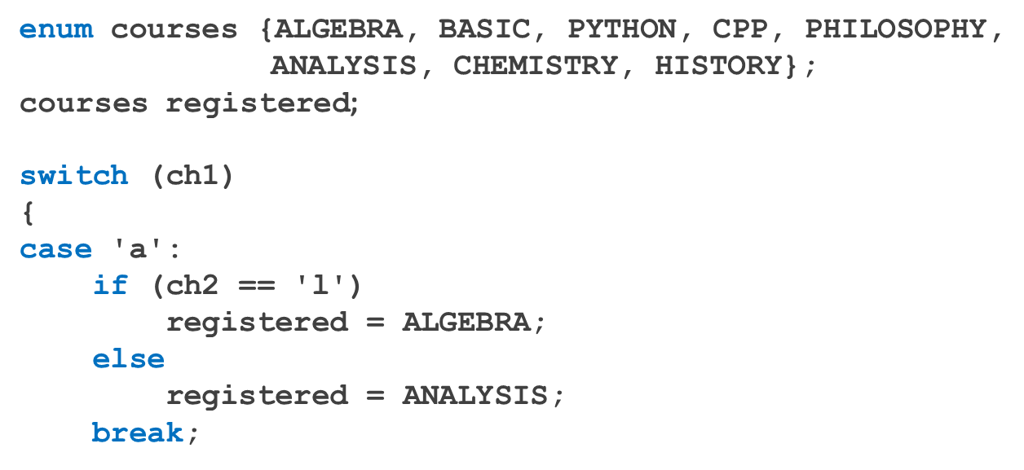
Input /Output of Enumeration Types
An enumeration type cannot be input/output (directly)
Because input and output are defined only for built-in data types such as int , char , double , etc
Can input and output indirectly – refer to code segments below:
You cannot assign word : “ALGEBRA” into variable registered. Instead, the index number will be assigned
https://replit.com/@btaylan/CISC3142Codes#Lecture-5/16.cpp

Slide 27
Functions and Enumeration Types
Enumeration types can be passed as parameters to functions either by value or by reference
A function can return a value of the enumeration type
https://replit.com/@btaylan/CISC3142Codes#Lecture-5/17.cpp

Slide 28
Declaring Variables When Defining the Enumeration Type
Can declare variables of an enumeration type when you define an enumeration type:
enum grades {A, B, C, D, F} courseGrade;
Course grade is a variable of grades type whose value can be A, B, C, D or F

Slide 29
Anonymous Data Types
Anonymous type values are directly specified in the declaration, with no type name
enum {BASKETBALL, FOOTBALL, BASEBALL, HOCKEY} mySport;
Drawbacks:
Cannot pass/return an anonymous type to/from a function
The same values used in one type can be used in another, but are treated differently
enum {ENGLISH, FRENCH, SPANISH, GERMAN, RUSSIAN} languages;
enum {ENGLISH, FRENCH, SPANISH, GERMAN, RUSSIAN} foreignLanguages;

Slide 30
typedef Statement
The typedef statement is used to create synonyms or aliases to a data type
The syntax of the typedef statement is:
typedef does not create any new data types
Only creates an alias to an existing data type
https://replit.com/@btaylan/CISC3142Codes#Lecture-5/18.cpp

